Slide 1
A FACE RECOGNITION SYSTEM USING COMPUTER VISION AND MACHING LEARNING BY: ABDULKADIR SANUSI K ATIKU H21CS097 A PROJECT SUBMITTED TO THE DEPARTMENT OF COMPUTER STUDIES HASSAN USMAN KATSINA POLYTECHNIC, KATSINA STATE IN PARTIAL FULFILLMENT OF THE REQUIREMENTS FOR THE AWARD OF HIGHER NATIONAL DIPLOMA IN COMPUTER SCIENCE MAY, 2024

Slide 2
INTRODUCTION
Face recognition has become a prominent area of research in computer vision (Jain, 2021). The process typically involves extracting facial features such as mouth width and eye width and comparing them with database records.
Utilizing pre-trained models is advantageous as it saves time and resources compared to building models from scratch (Krizhevsky et al., 2012). Tensor Flow, an open-source AI library developed by Google, offers tools and libraries for model building and experimentation.

Slide 3
STATEMENT OF THE PROBLEM
Despite the remarkable progress in face recognition technology, there are still several challenges that researchers and practitioners aim to overcome. Issues such as occlusions, variations in facial features due to aging, and the need for real-time processing in dynamic environments pose significant obstacles.
This study seeks to address these challenges and contribute to the ongoing improvement of face recognition systems using Convolutional Neural Networks.
How to accurately identify faces from images.
How to effectively classify faces into different categories (e.g., age, gender, emotion).

Slide 4
AIMS AND OBJECTIVES
The primary aim of this research is to design, implement, and evaluate a Face Recognition System based on Convolutional Neural Networks. The specific objectives include:
To review existing literature on face recognition systems, emphasizing the role of Convolutional Neural Networks.
To develop a robust and efficient face recognition system using state-of-the-art CNN architectures.
To assess the performance of the proposed system under various conditions, including variations in lighting, pose, and facial expressions.

Slide 5
METHODOLOGY
If the research involves the development of software, this section will outline the methodology followed in the software development lifecycle. It may include methodologies such as Agile, Waterfall, or Spiral model, along with specifics regarding requirements gathering, design, implementation, testing, and deployment phases

Slide 6
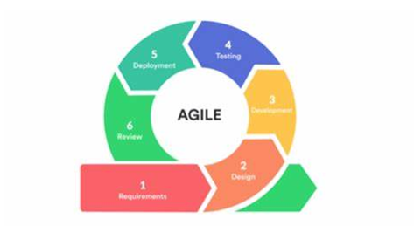
Agile project management is a methodology widely used in software development that emphasizes adaptability, collaboration, and iterative progress. The Agile approach breaks down the project into smaller increments called iterations or sprints, allowing teams to deliver usable and valuable software quickly and continuously improve it based on feedback. The Agile life cycle consists of six key stages, represented in a circular diagram:

Slide 7
RESULT AND DISCUSSSION
System analysis is a detailed examination of a system’s components and how they interact with each other to achieve specific objectives. it involves understanding and documenting the system’s functionality, performance , requirements. this process is critical for designing, developing, and implementing a effective system in the context of face recognition system.

Slide 8
CONCLUSION AND RECOMMENDATION
In this study, we have successfully developed a face recognition system using machine learning techniques. The system demonstrates high accuracy, robustness to varying conditions, and real-time processing capabilities. Through careful data collection, preprocessing, model training, and integration, we have achieved our primary objectives.
While the face recognition system has shown promising results, there are several avenues for future research and improvement:
Enhanced Robustness: Further research can focus on improving the system's robustness to extreme conditions such as low lighting, occlusions, and pose variations. Techniques like data augmentation and adversarial training could be explored to enhance the system's generalization ability.

Slide 9
THANK YOU

